Slide 1













FLEX
Your own Food & Workout assistant
by Team L
Losers

Slide 2


Contents
Contents 01
Contents 02
Contents 03
Objective, milestone
Role of members
Challenges , Limits
Contents 04
Contents 05
Contents 06
Designs of our App
About of our
FN, BN, AI
Done & Next goals

Slide 3




Core Objective
Core goals of the project
Give preferred foods.
And Maximize the preferred foods according to resources
Food recommend
User preference
Make Workout program dynamical based on users meal.
Workout recommend
AI

Slide 4


Role of members
신재욱
Backend
Backend Developer , datamining
홍마노
AI
AI/DS developer, datamining , AI modeling
Manu gomez
AI
AI/DS developer, datamining , AI modeling
이지훈
Frontend
Frontend developer, UI/UX design

Slide 5



Challenge & Limit
Food recommend
Workout recommend
We met many troubles in recommend foods with preference score
In last presentation, we said we’ll go with auto encoder for solve these problems.
But, actually, auto encoder can’t help us .
troubles
We wanted to AI model for recommend Workout routine, but our data sets are not enough for getting meaningful result (for training model)
So..,,
We recommend food with only for input text for each day. And recommend Workout routine for our own algorithm.

Slide 6
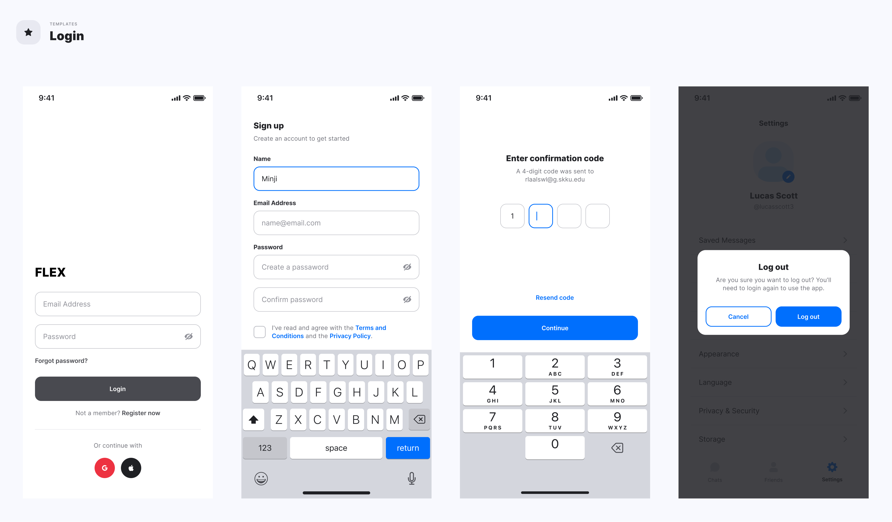
UI / UX Design
Notes:
로그인 화면

Slide 7
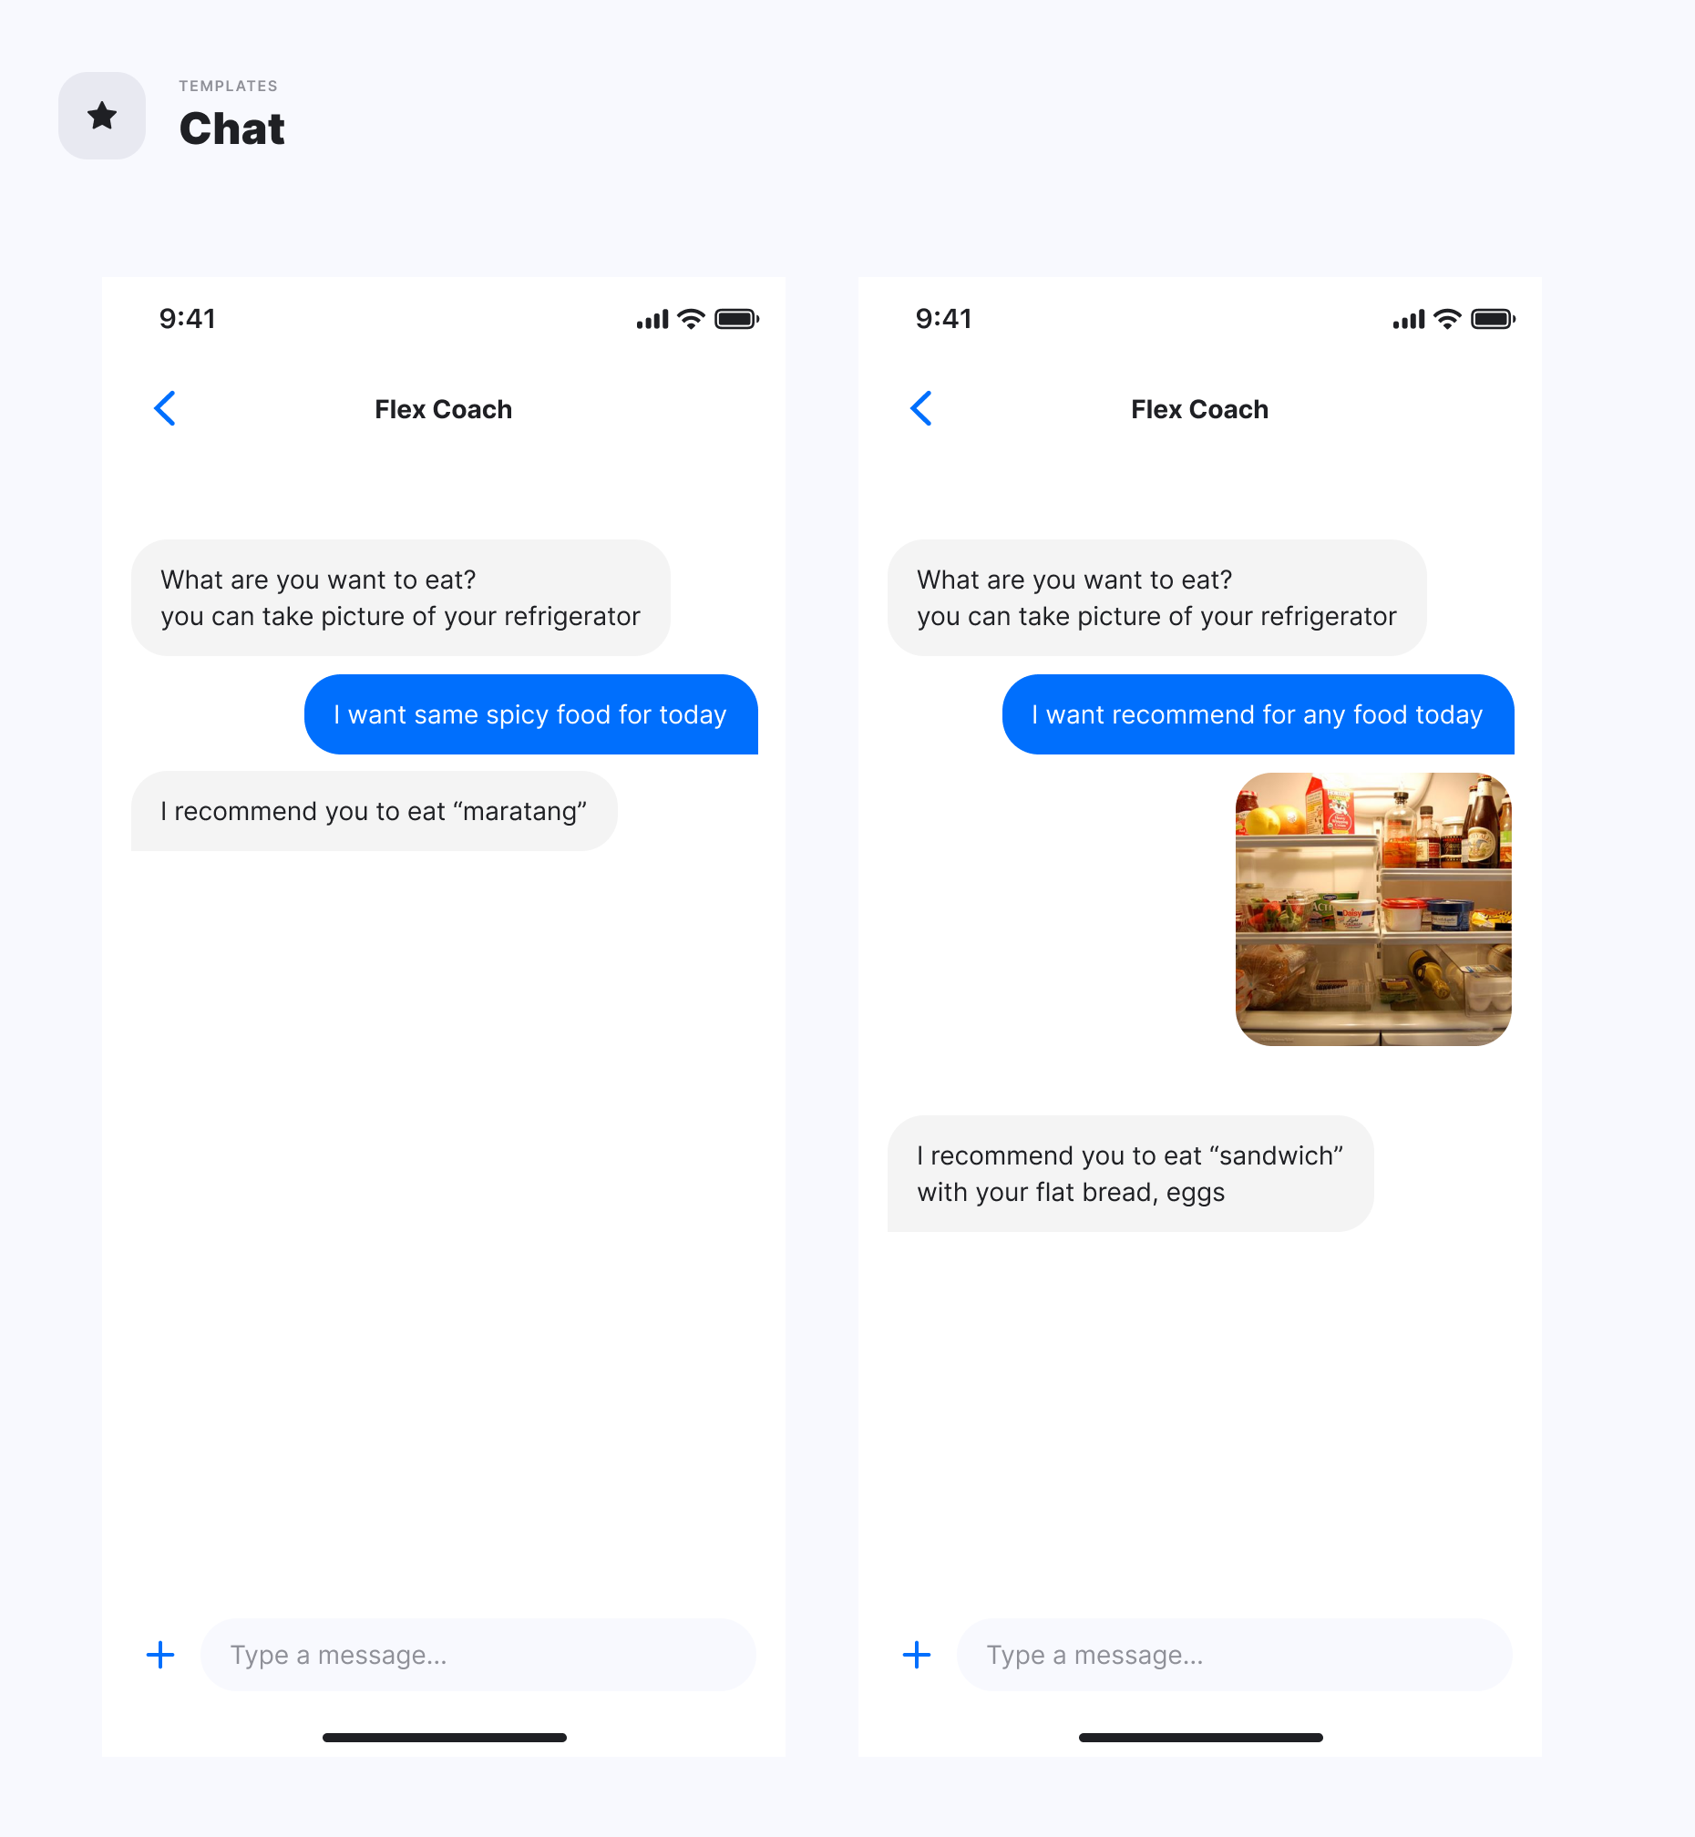
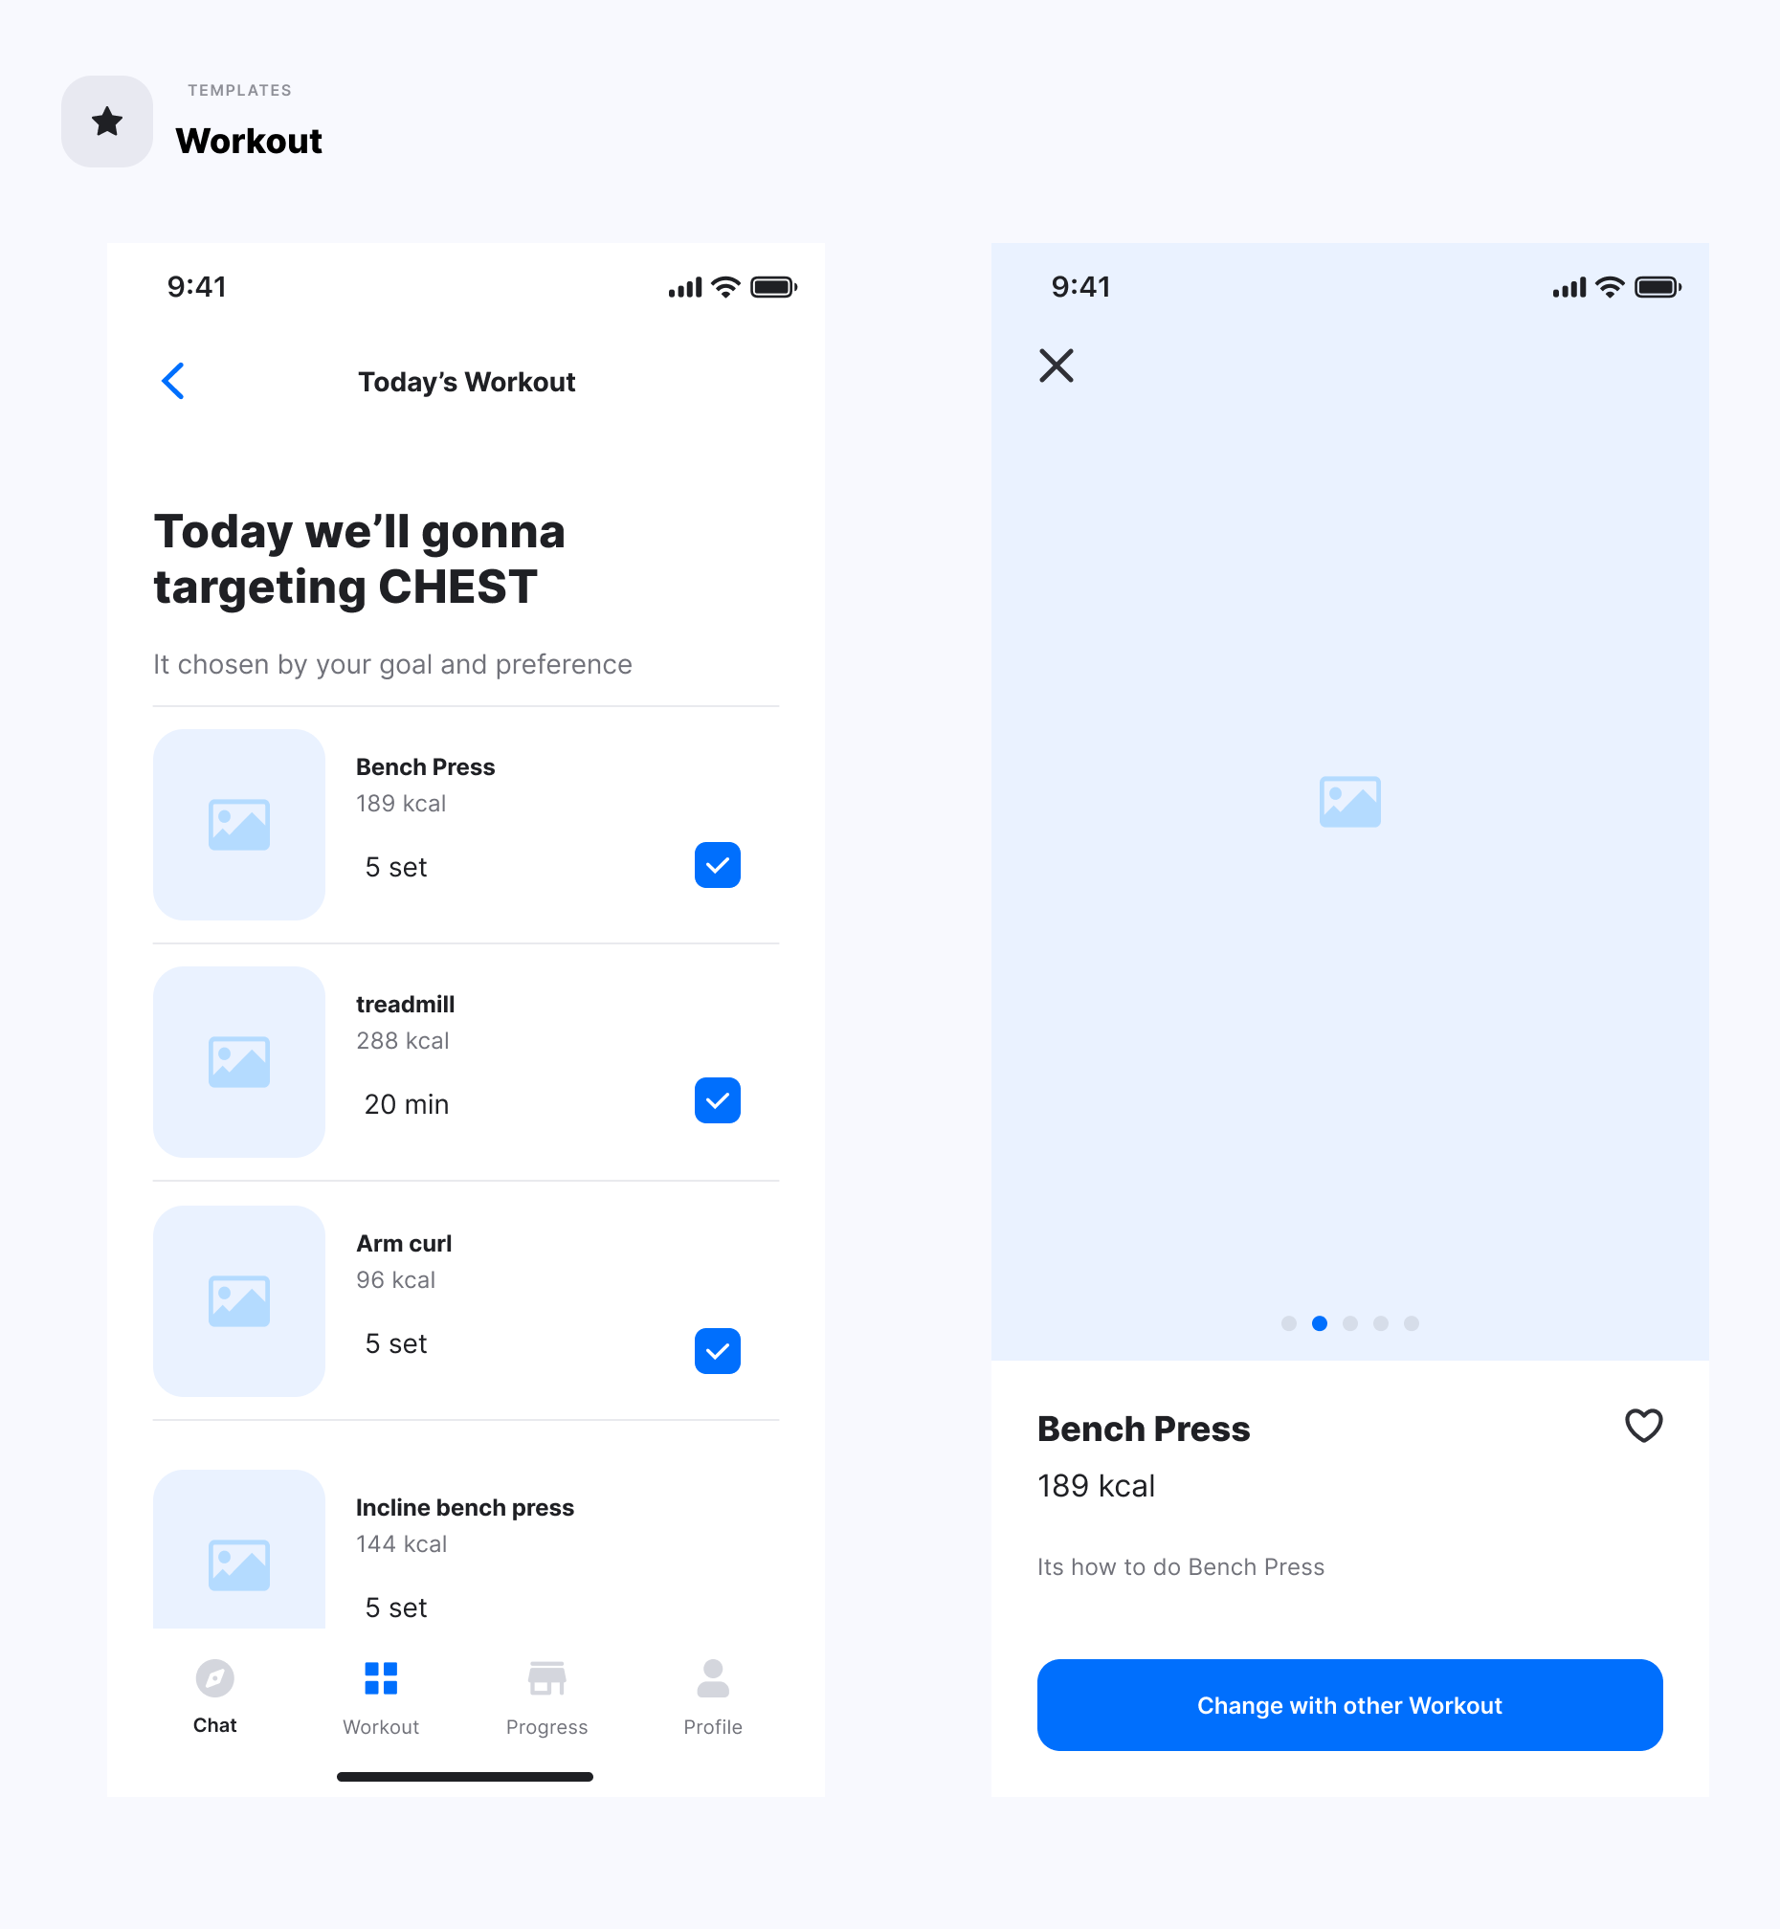
UI / UX Design
Notes:
Chat 은 음식 추천 채팅
두번째는 운동 추천 화면

Slide 8
Implementation
Frontend & Backend
With Django & React Native
0
DB design
01
02
Signup/Login process
Make server API endpoint for food recommend

Slide 9
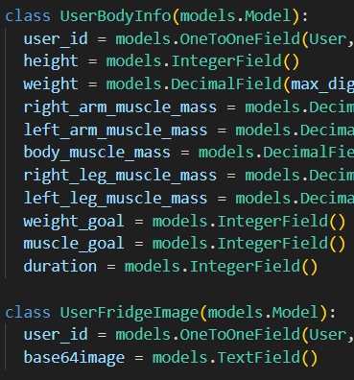
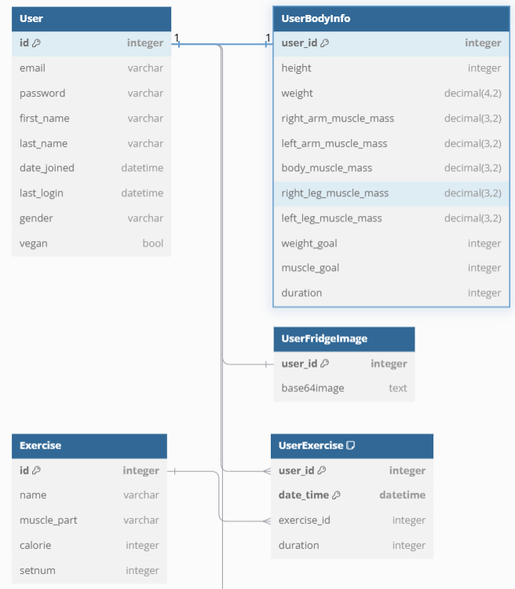
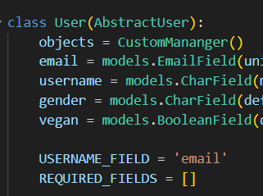
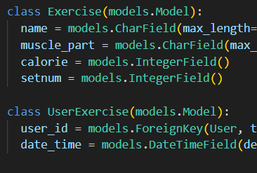
Implementation
Backend _ DB design

Slide 10
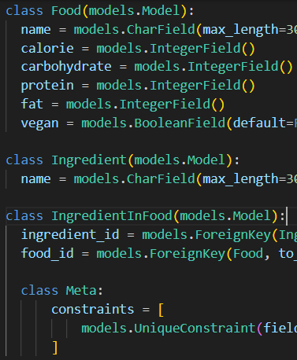
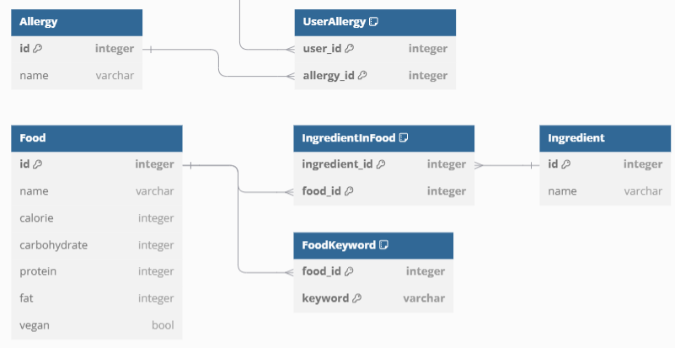
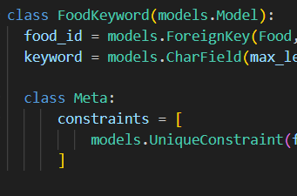
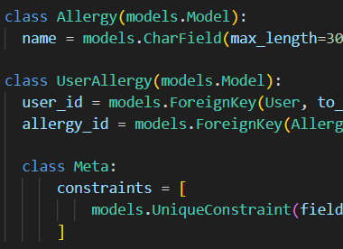
Implementation
Backend _ DB design

Slide 11
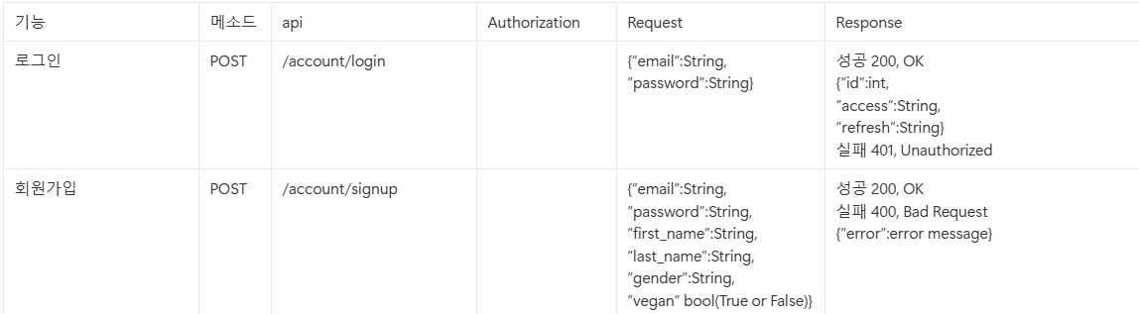
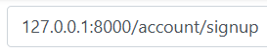
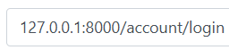
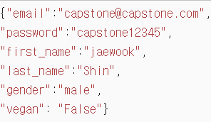
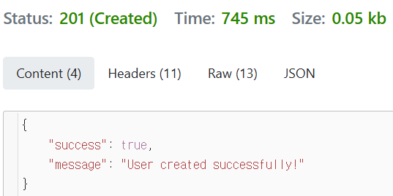
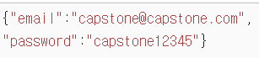
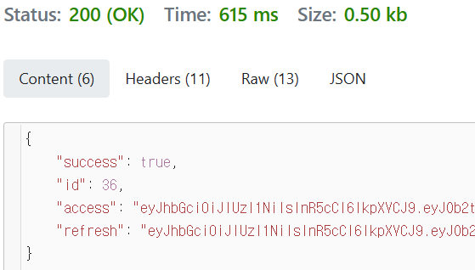
Implementation
Backend _ Sign Up/Login API

Slide 12
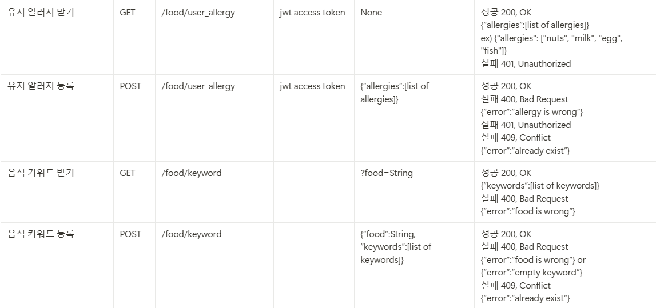
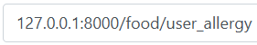
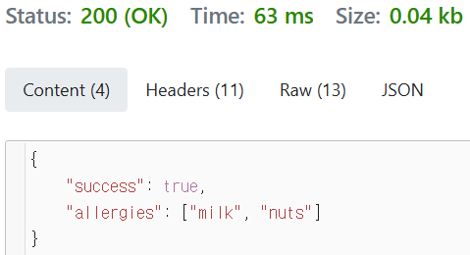
Implementation
Backend _ Food Related API

Slide 13
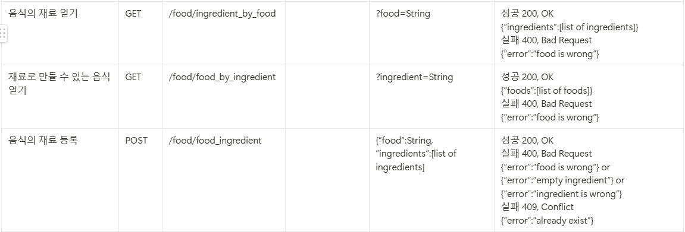
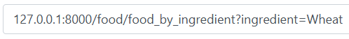
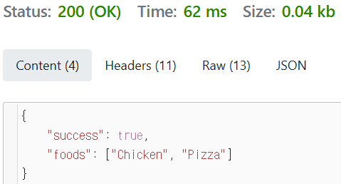
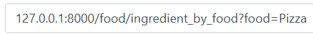
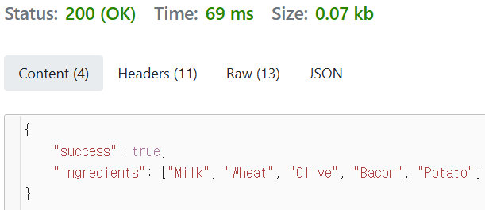
Implementation
Backend _ Food Related API

Slide 14
Implementation
Backend _ Food Related API

Slide 15
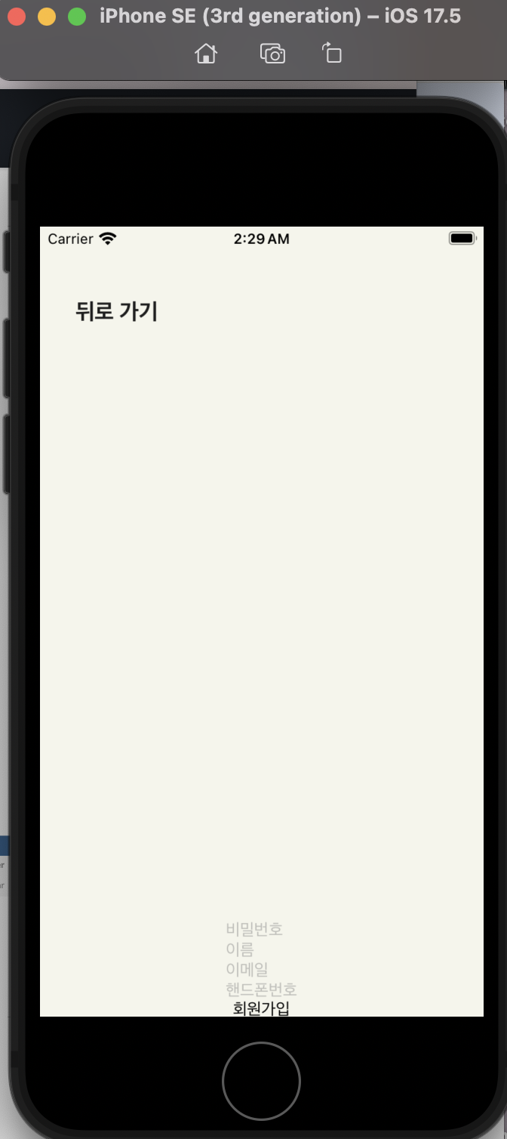
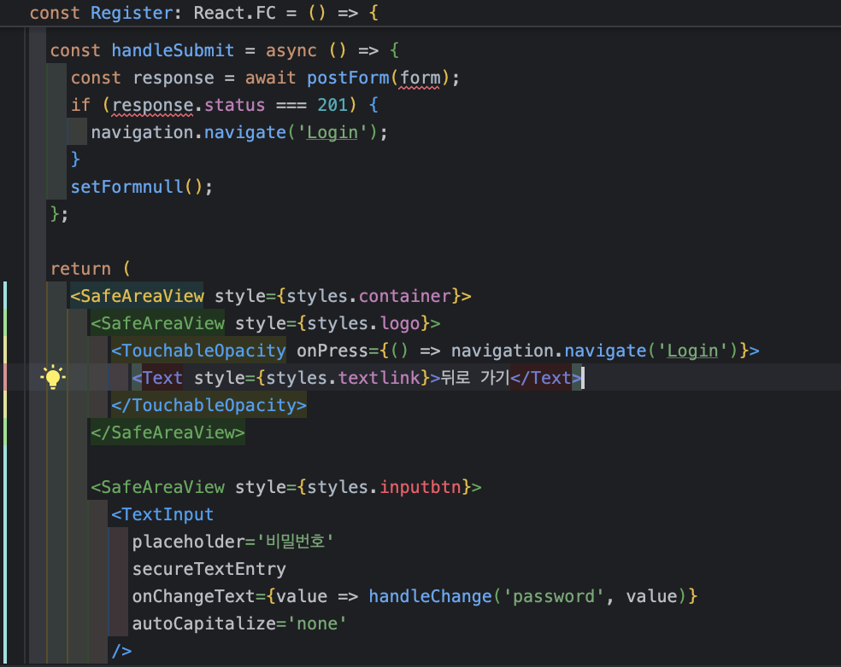
Implementation
Frontend _ Make connection with server without design (Login, Register)
Notes:
별거 없고 그냥 타입스크립트로 회원가입창, 로그인창 만들어서 로그인 되는지 확인해봤다. 디자인은 아직 안돼있으니 양해 부탁한다 .

Slide 16
About our AI
1. Goals
Give preferred foods
Maximize the preferred foods according to resources
NOT get perfect food (unreal)

Slide 17
About our AI
2. Inputs
User’s allergies + diet preferences (Vegetarian…) → Multiple choice question
User’s blank text about food preferences (Chicken…) → Blank text
User’s fridge photos → Upload photos

Slide 18
About our AI
3. Main Idea
Analyze user’s text → Keyword positive, negative…
Connect user’s keywords with foods’ description keywords
3. Analyze fridge photos for score.

Slide 19
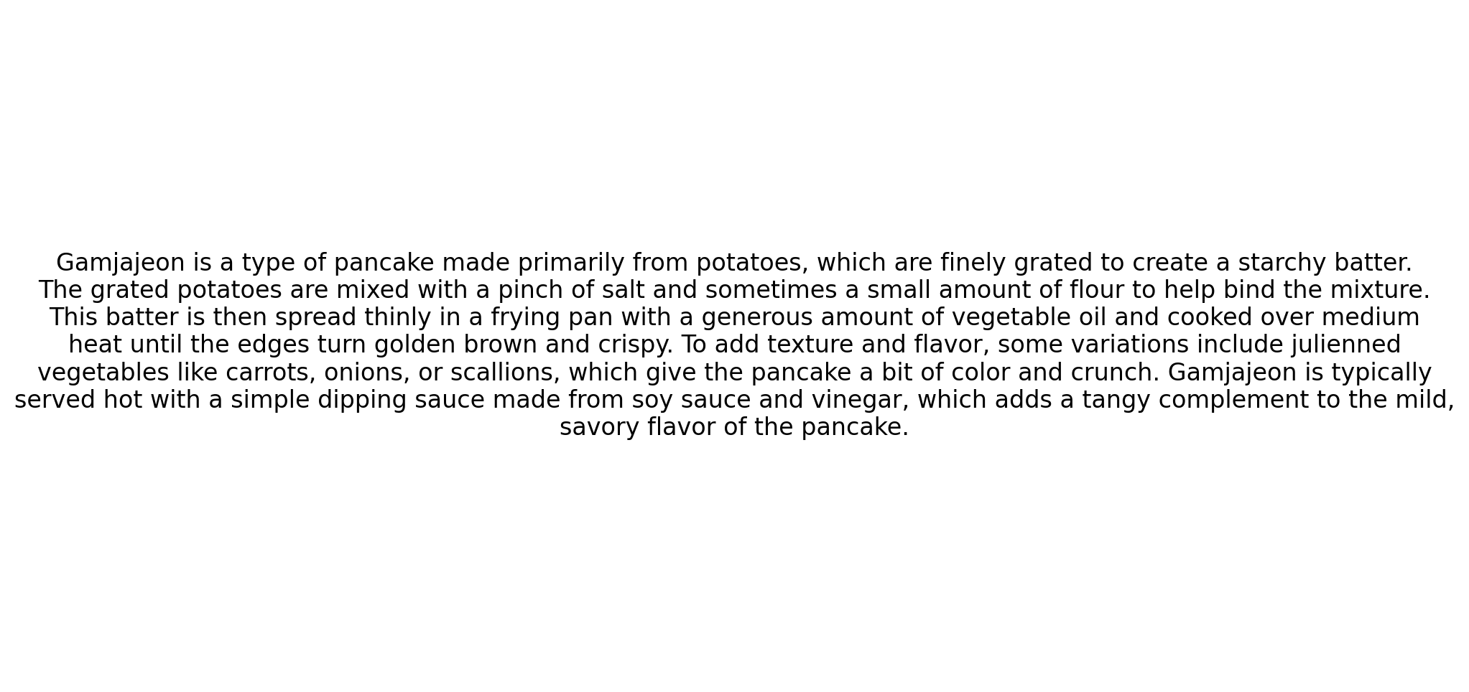
About our AI
4. Datasets (Food)
Columns:
Food name
Ingredients
Allergies
Vegetarian…
Description

Slide 20
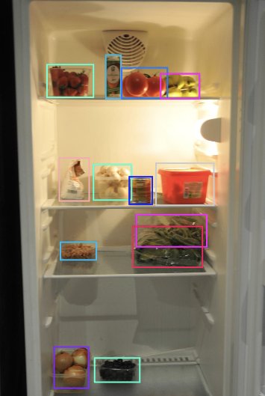
About our AI
4. Datasets (Fridge)
Subset of the recipe1M dataset
516 photos
Labels:
<class>
<x_center>
<y_center>
<width>
<height>

Slide 21

About our AI
5. Preprocessing ( Eliminate )
User’s allergies foods
Diet preferences foods (Vegans…)

Slide 22
About our AI
5. Preprocessing ( Keywords )
Tokenization and lemmatization → nltk
Stopwords removal
POS tagging + NER → Keyword extraction

Slide 23
About our AI
5 (2). Positive or Negative
Aspect-Based Sentiment Analysis
Input: User’s full text + Aspect (Keyword)
Output: Positive-Neutral-Negative

Slide 24
About our AI
5 (3). Connect user’s text with foods’ ingredients
Embeddings and similarities
Generate embeddings for each keyword → all-MiniLM-L6-v2 (BERT)
2. Calculate similarity between keywords → User’s text and description

Slide 25
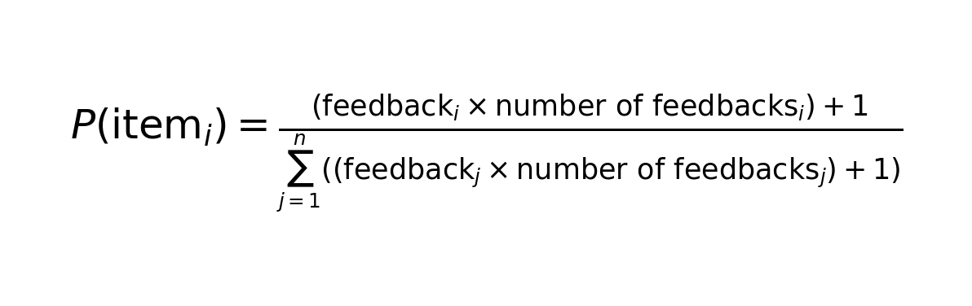
About our AI
5 (4). Scores
Scoring
Similarity found → Positive add score. Negative minus score
Draw → User’s feedbacks
Multiply fridge’s photos score (Optional)
Show top 5 foods

Slide 26
About our AI
5 (5). Example
input
Allergies: peanuts
User’s text: I will like to eat a dish with chicken but I don’t want anything spicy at all.

Slide 27
About our AI
5 (5). Example
Process
Eliminate any peanut allergic food
2.Tokenize → "I","will","like","to","eat","a","dish","with","chicken","but","I","don’t","want","anything","spicy","at","all”
3. Lemmatize and remove stopwords → ['like', 'eat', 'dish', 'chicken', 'want', 'anything', 'spicy’]
4. POS tagging + NER → ['chicken', 'anything', 'spicy']
ABSA → {'chicken': 'positive', 'anything': neutral, 'spicy': 'negative'}

Slide 28
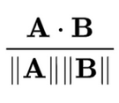
About our AI
5 (5). Example
Process
5. Get dishes keywords’ embeddings and user’s text keywords’ embeddings → “Chicken”: [-4.19756360e-02 - 1.32821249e-02…]
6. Calculate similarities →
7. Threshold pass → Positive: Add (+1) Negative: Minus (-100)
8. Fridge photos?

Slide 29
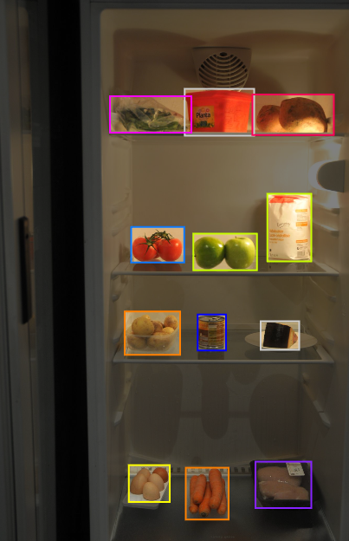
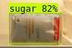
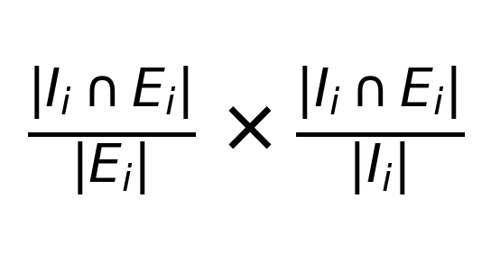
About our AI
6. Fridge photos (multiple)
Process
YOLO or ResNext
Analyze bounding boxes
Same dataset (30 classes)
Bigger food dataset (Resnet)
Scoring
Set of recorded ingredients for food i.
Set of expected ingredients for food i.

Slide 30
About our AI
7. Output
User’s text. => Top 5 most preferred
User’s text + Fridge Images => Top 2 most preferred + 3 (most preferred + fridge score)

Slide 31
About our AI
8. Technical explanation
Aspect-Based Sentiment Analysis
Input Construction with Aspect Embedding
Embedding
Aspect-Aware Attention [SEP]
Trained for Sentiment Classification

Slide 32
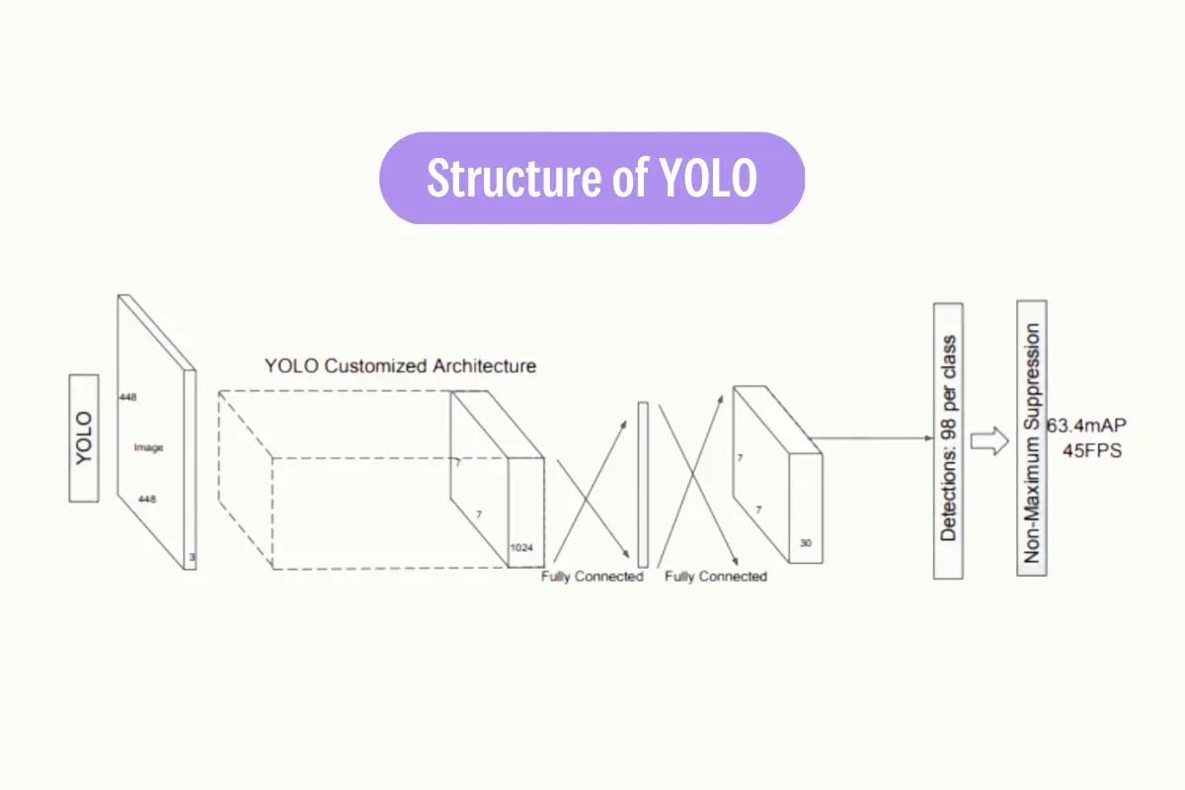
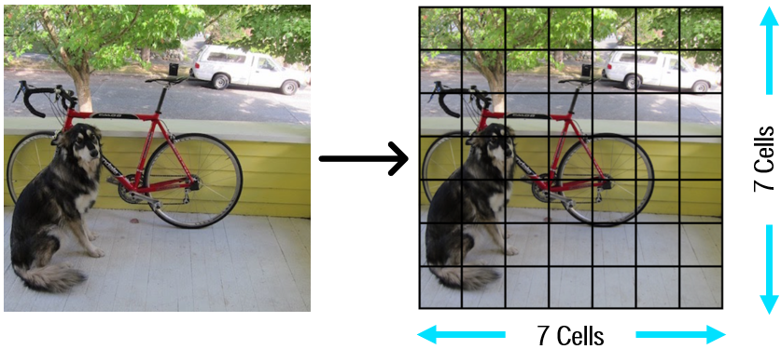
About our AI
8. Technical explanation
YOLO
Input Image Division and Grid Formation
Bounding Box Predictions and Confidence Scores
Class Probabilities
Single Forward Pass with
Convolutional Neural Network
Non-Max Suppression → Confidence

Slide 33
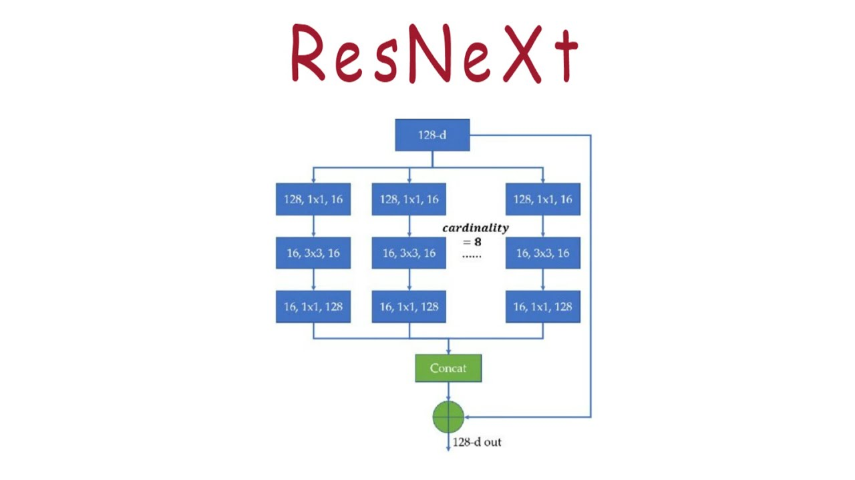
About our AI
8. Technical explanation
ResNext
Building Blocks: Residual Connections
Split-Transform-Merge (Aggregated Residual Transformations)
Cardinality
ResNeXt Block

Slide 34

About our AI
8. Technical explanation
Loss Function and Metrics
Loss: Intersection over Union Loss
2. Metric: Intersection over Union

Slide 35
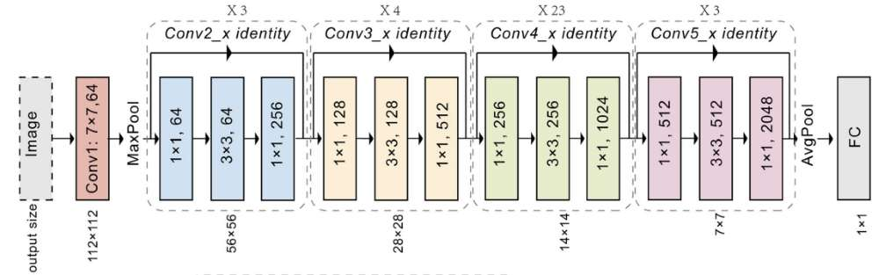
About our AI
8. Technical explanation
ResNet
Problem with Deep Networks
Residual Block
Stacking Residual Blocks
Identity and Projection Shortcuts
Training Benefits of Residual Connections
Loss: Cross Entropy
7. Metric: mAP, Precision and Recall

Slide 36

About our AI
9. Hyperparameters
Similarity threshold
Anchors
Batch size
Learning rate
Image size
IoU threshold
Non Maximum Suppression threshold
Cardinality
Depth
About of our
FN, BN, AI

Slide 37
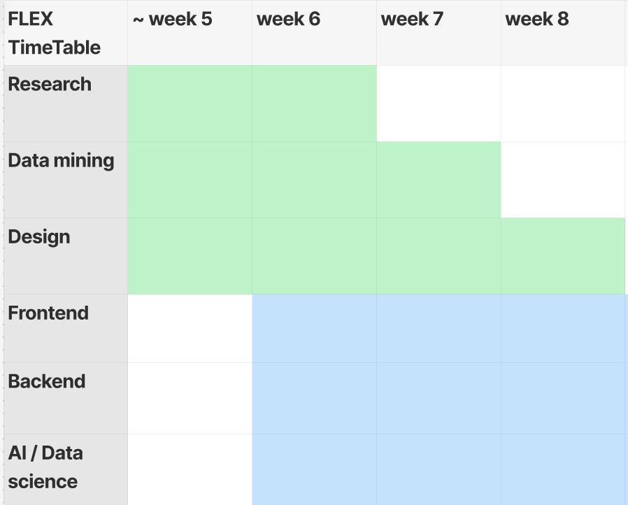
Done & Next goal
Week Table

Slide 38
Done & Next goal
Progress done or doing
Datasets and keywords
Descriptions
NER
Embeddings
ABSA problem
Preprocessing images + Previous researches

Slide 39
Done & Next goal
Progress done or doing
Datasets and keywords
Descriptions
NER
Embeddings
ABSA problem
Preprocessing images + Previous researches
Design UI / UX
Make Login & Register process and integrate client & server

Slide 40
Done & Next goal
Future Process
Solve ABSA
Threshold for similarities
Try YOLO and ResNext → Bounding boxes
Optimize the hyperparameters
Data Augmentation
Resnet for ingredient class
Make Workout Algorithm & Whole API endpoint in server And deploy on AWS EC2
Make whole pages and components for client (frontend)

Slide 41


Thank you

